Slide 1
Quantum Theory
Heisenberg's uncertainty principle
According to classical mechanics and Bohr’s theory
Exact and simultaneous determination of both position and momentum of a moving body is possible.
but for Microscopic particle, such as electron it is not possible to detect position and velocity (momentum) accurately and simultaneously at any time, because it has wave and particle nature.

Slide 2
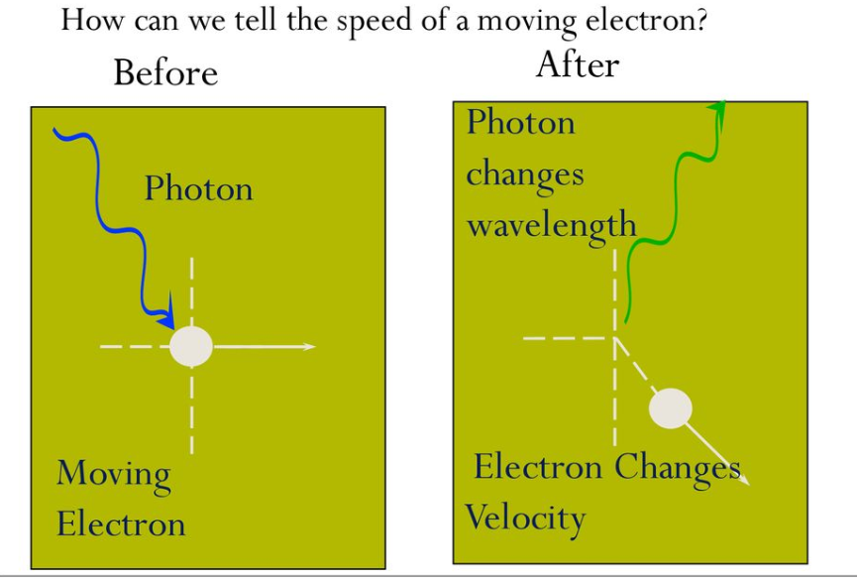
Energy operator
It has no physical meaning if only it is written. For example square root is an operator. If a quantity or number is put under it.
It transform the given quantity in to its square root, which is another quantity.

Slide 3
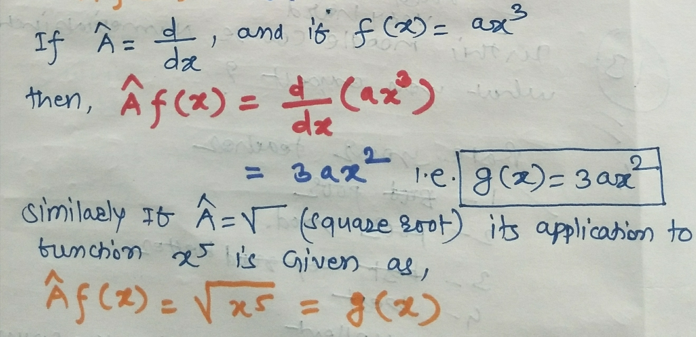
Energy operator
Mathematically we can write,

Slide 4
Energy operator

