Slide 1
Lecture 5 Electrolytic Conductivity
Prof. Rajesh M Kharatmol
Dept. of chemistry
RSB Mahavidyalay, Aundh

Slide 2
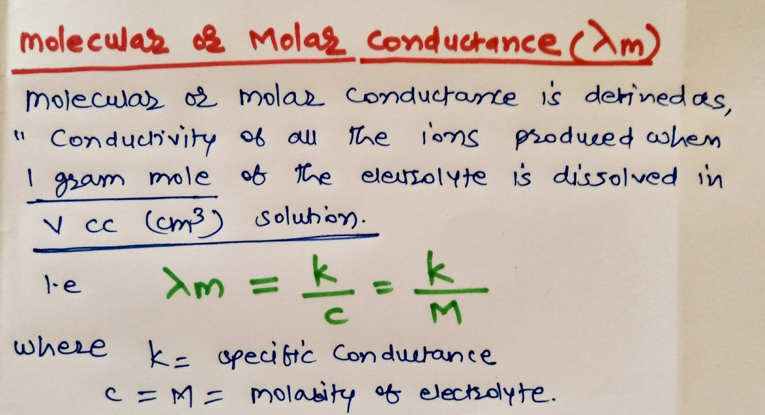
Molecular or molar conductance…………

Slide 3
Molar conductance…………

Slide 4
Effect of Dilution on conductivity…………

Slide 5
Equivalent conductance…………

Slide 6
Equivalent conductance…………

Slide 7
Equivalent conductance…………

Slide 8
Thank you…..

