Slide 1
Explanation of the Terms
Conductance and Specific resistance

Slide 2
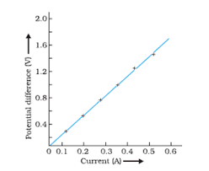
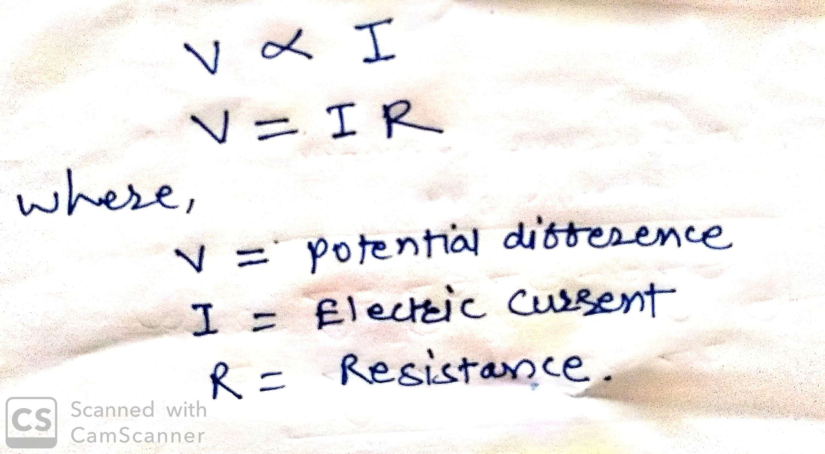
Conductance or Conductivity (G)
For understanding Conductance we must know firstly Ohms law.
What is Ohms law?
If physical state of the conductor remaining same, Electric current flowing through the conductor is always directly proportional to the potential difference between the two ends of conductors.

Slide 3
How to remember Ohms Law?
You know Salman khans movie VEER
It can also be written as VIR
VIR is as V=IR

Slide 4
Conductance or conductivity:-
According to ohms law, I is directly proportional to 1/R
Hence the quantity 1/R is a measure of conducting power and it is known as conductance (G) i.e. G=1/R.
It is also defined as, the reciprocal of resistance or it is simply capacity of substance to conduct electricity.
Unit:
It is measured in reciprocal of resistance i.e. per Ohm.
The SI unit of conductance is Siemen (S) which is equal to per ohm.

Slide 5
Specific Resistance (rho)

