Slide 1
Electrolytic conductivity
Lecture-6 equivalent conductance at infinite dilution

Slide 2
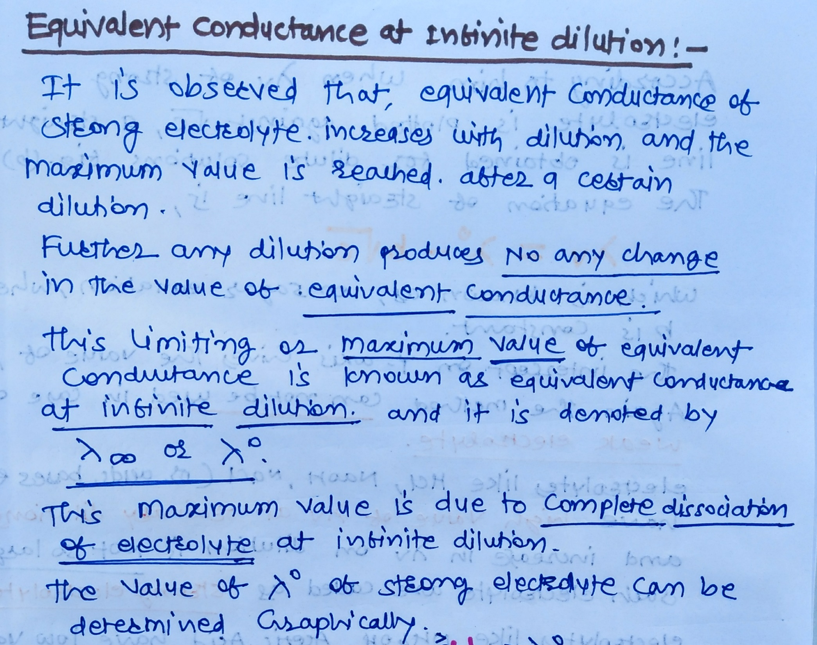

Slide 3
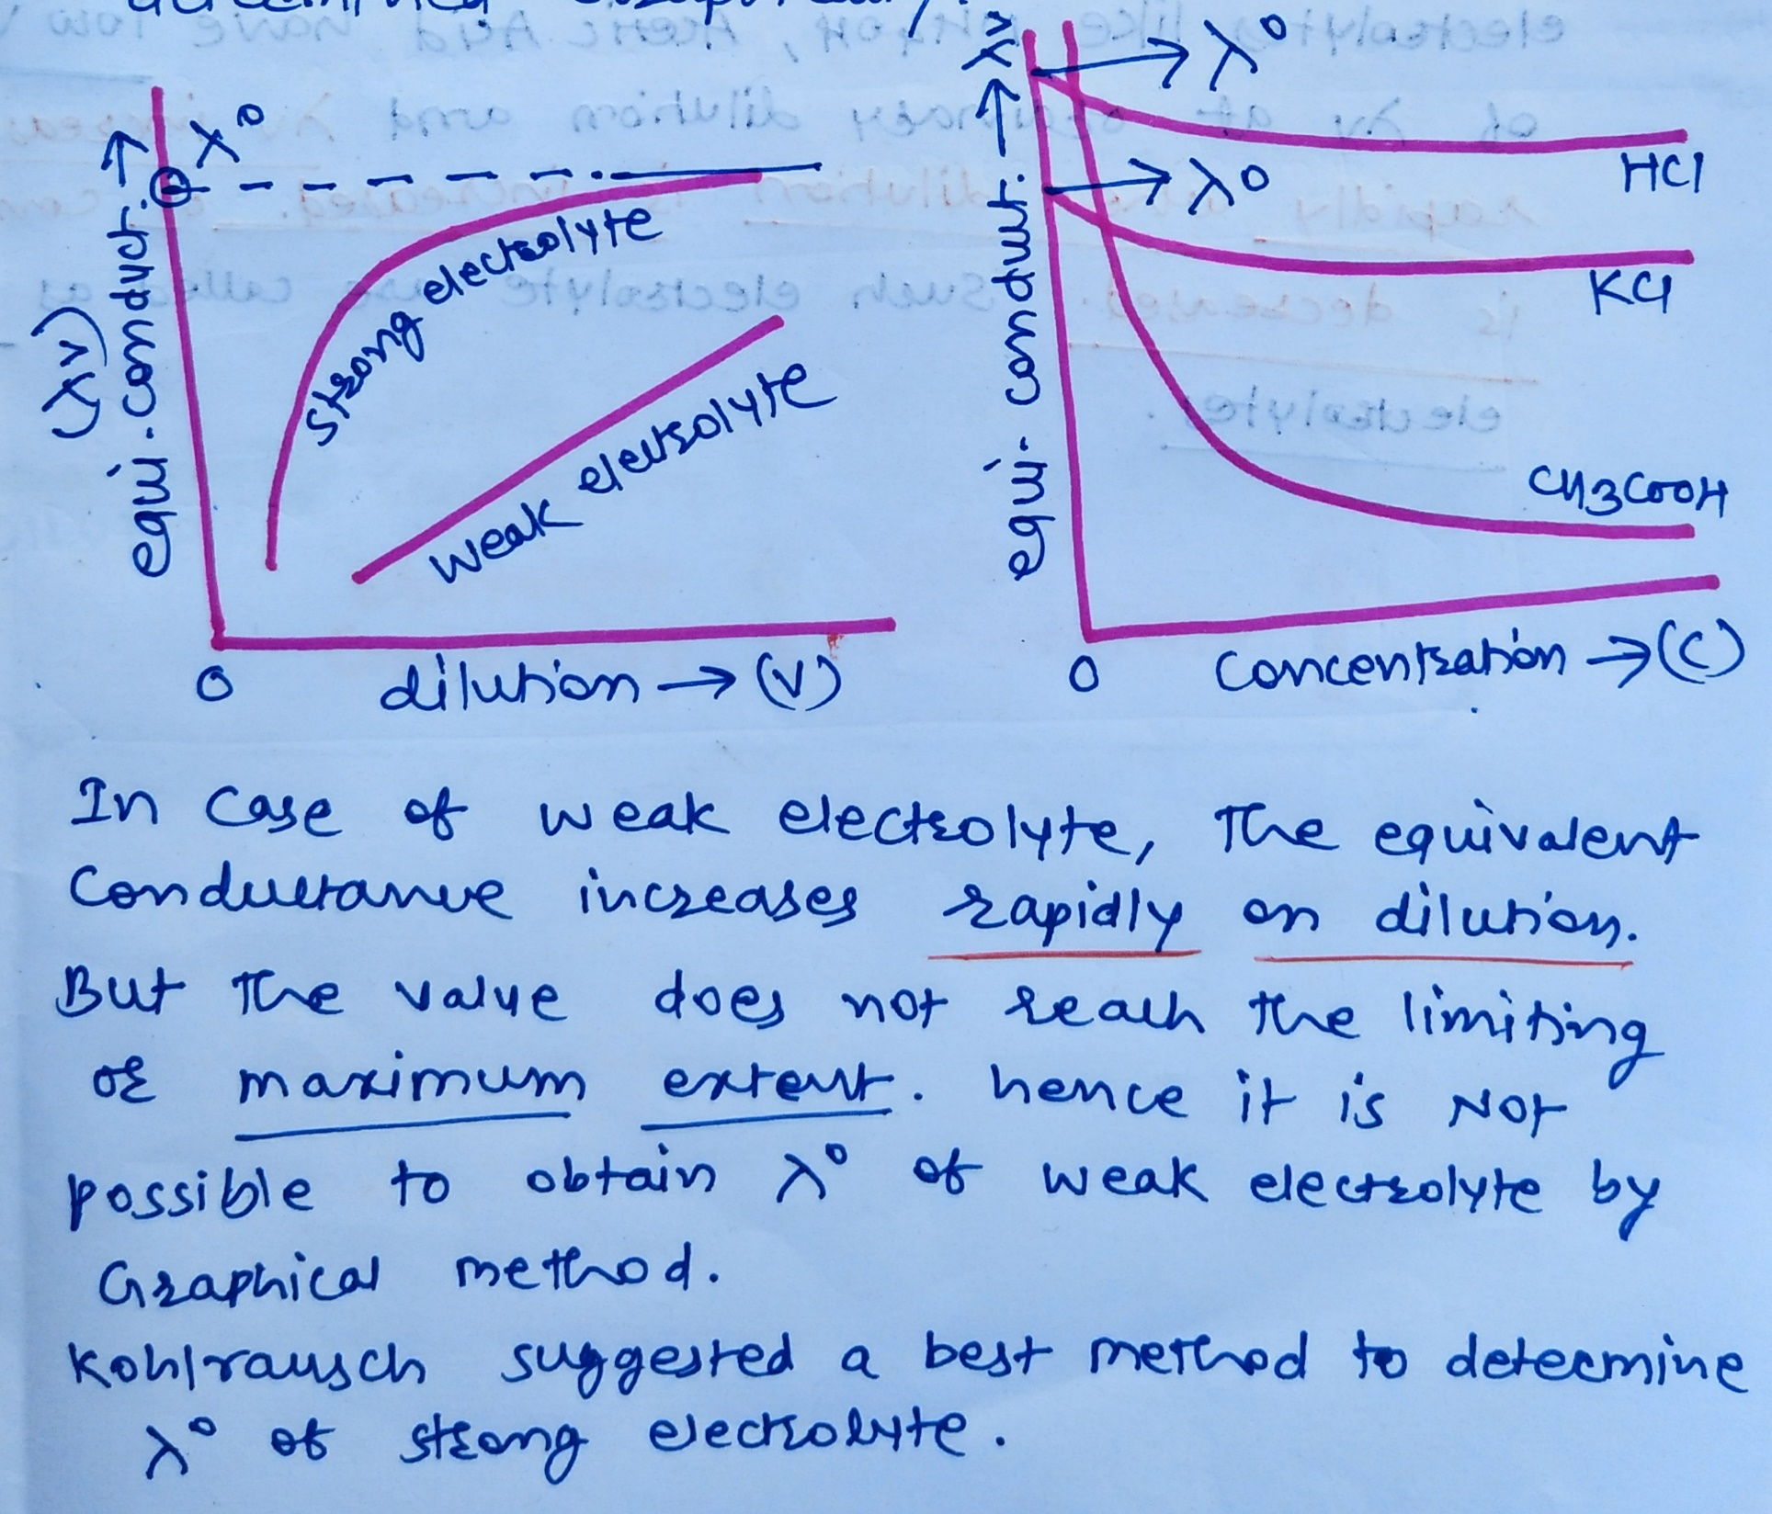

Slide 6
Thank you……..

