Slide 1
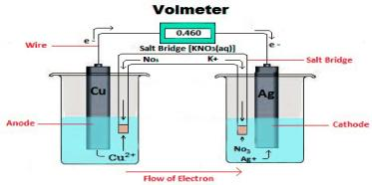
Electrochemistry Numerical Lecture 2
Prof. Rajesh M Kharatmol
Dept. of Chemistry, RSBM Aundh

Slide 2
In this lecture we will learn…..
How to calculate Molar conductance
How to calculate Equivalent conductance
When Specific conductance & specific resistance is Given

Slide 3
Numerical-2

Slide 4
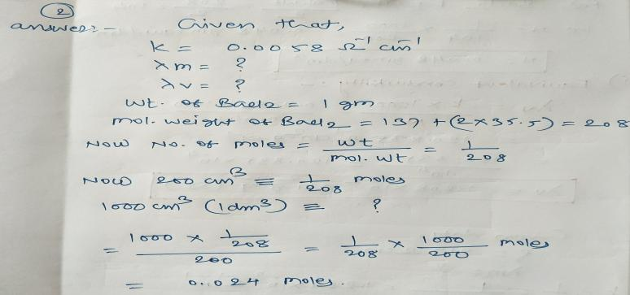
Solution…..

Slide 5
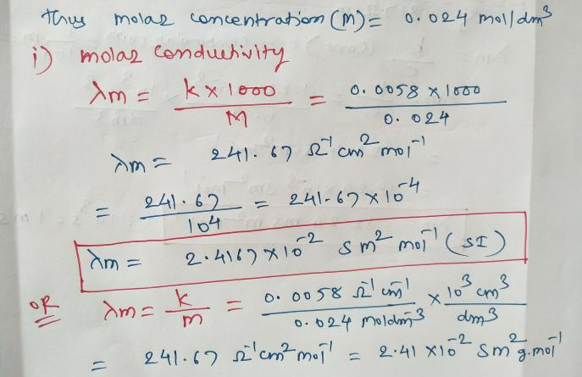

Slide 6
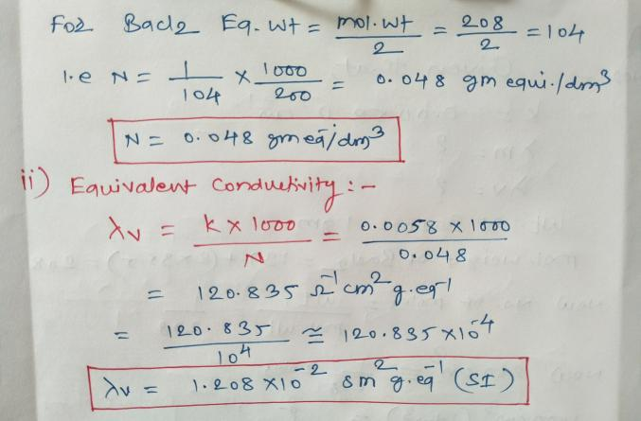

Slide 7
Numerical 3

Slide 8
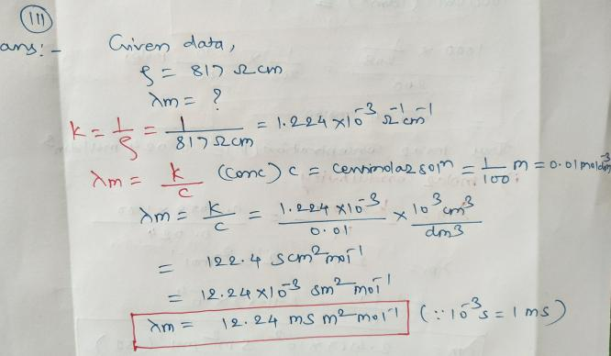
Solution…..

